Slide 1
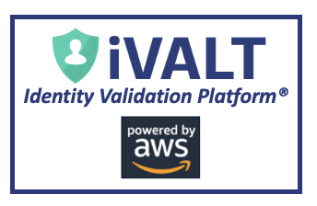
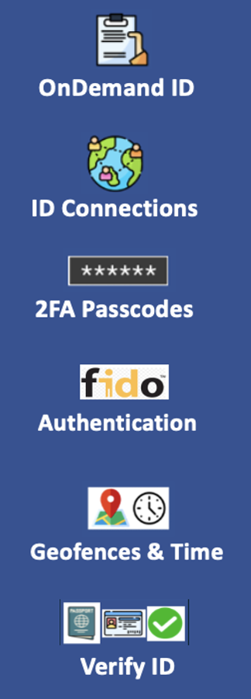



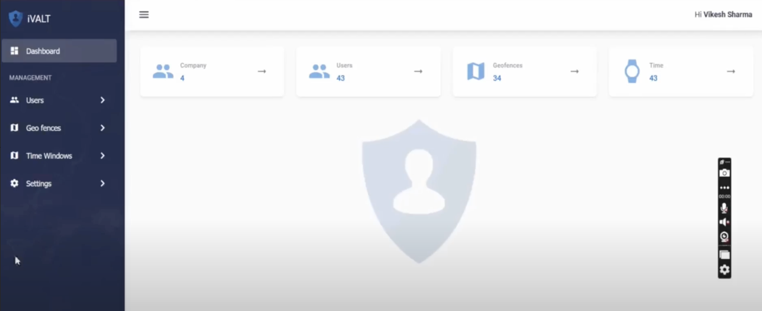


Solution Components
iVALT Building Blocks
Unique SaaS Tenant
Mobile App
Enterprise IT and Dev Tools for New Prod Dev and IAM
AI Agent Identity Code
IOT Device Code
(ARM or RISC-V)
Libraries
“ID Connection”
Integrations
Admin Portal
OAuth 2.0, OIDC, SAML, FIDO2
(MFA, CIBA)
User Management
A Standardized and Simple Starting Point

Slide 2
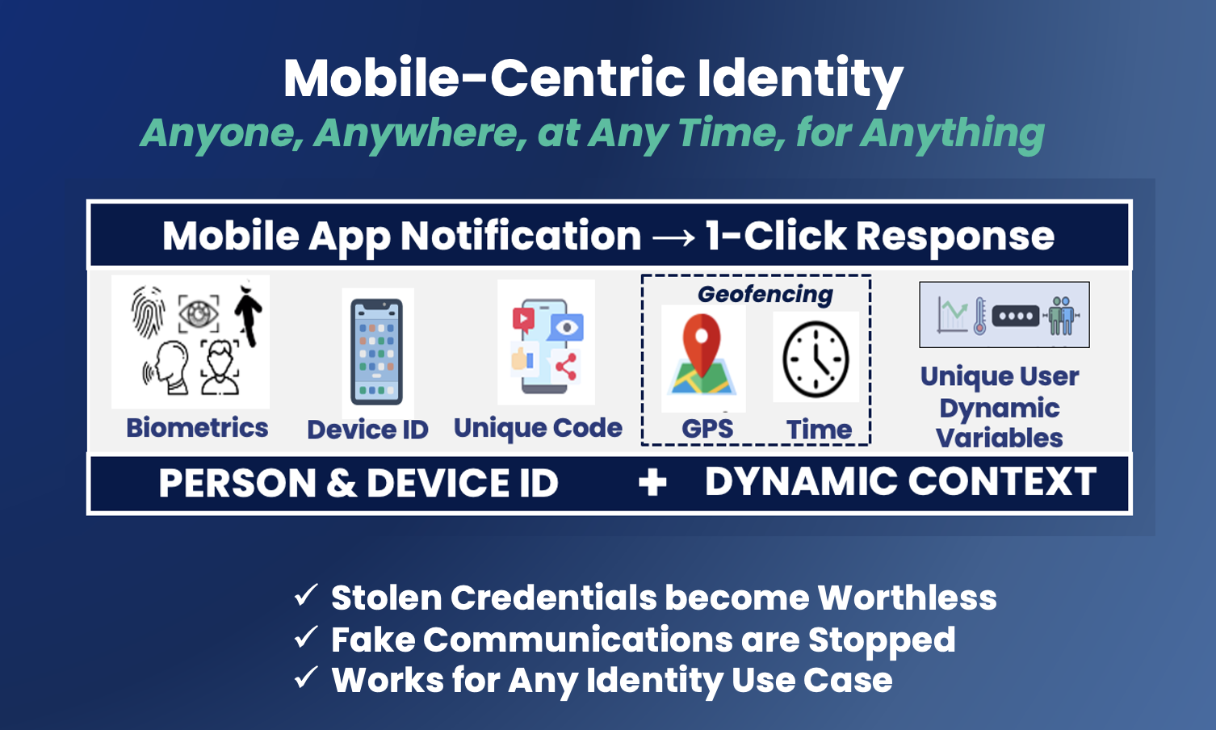
Human Identity Verification
The Same UX for Every Use Case

Slide 3
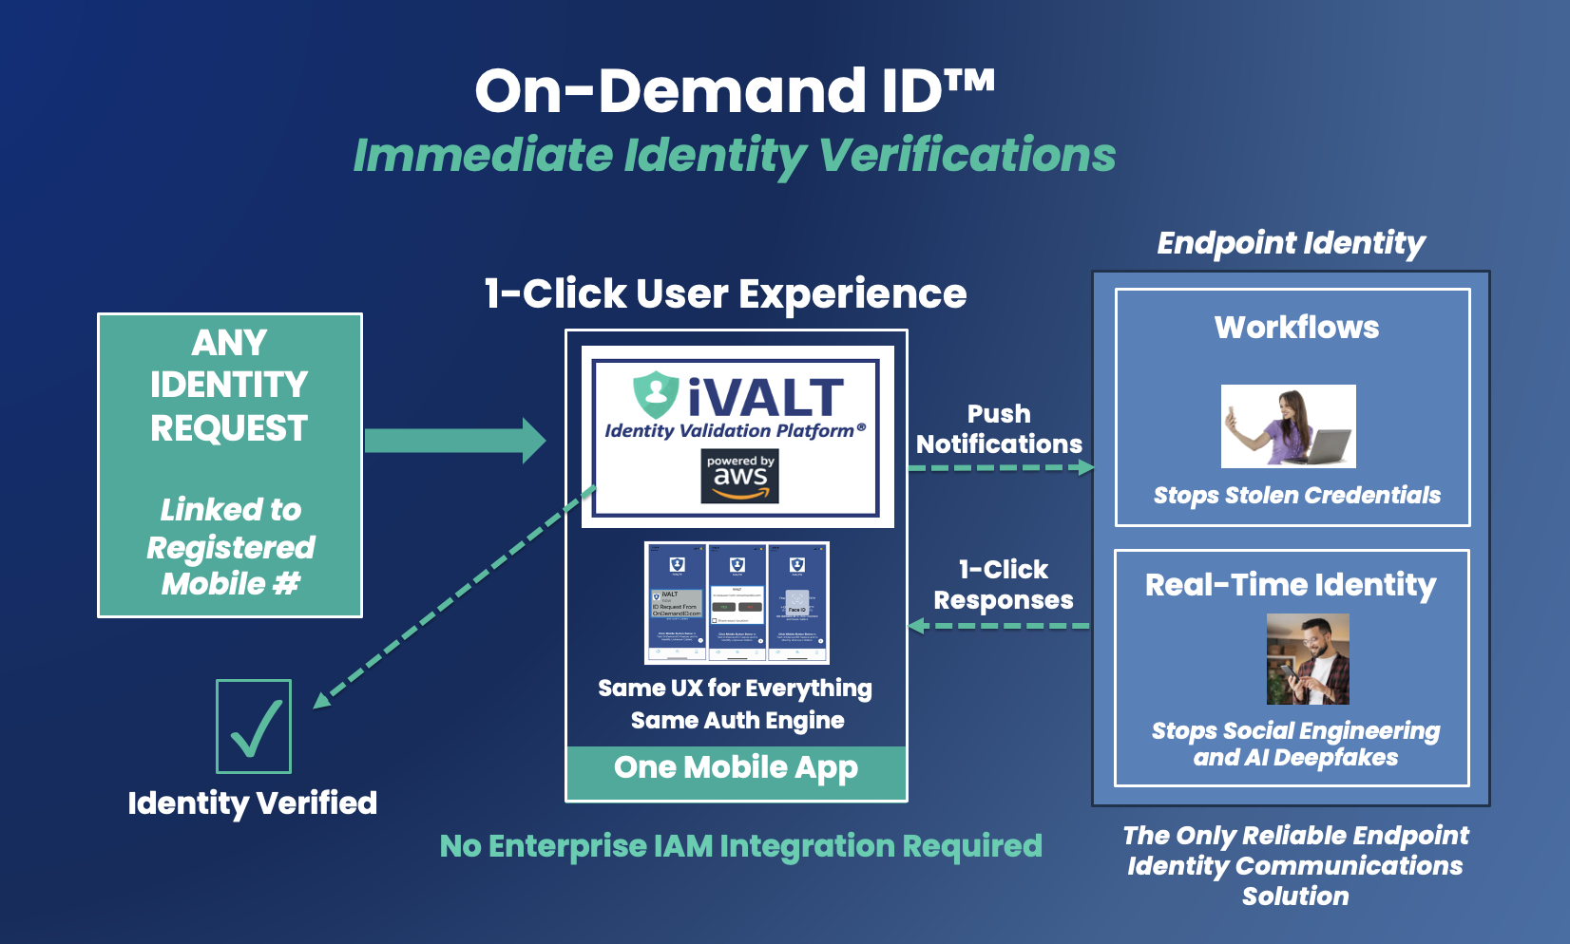
5+ Factors of Identity in 1-Click

Slide 4
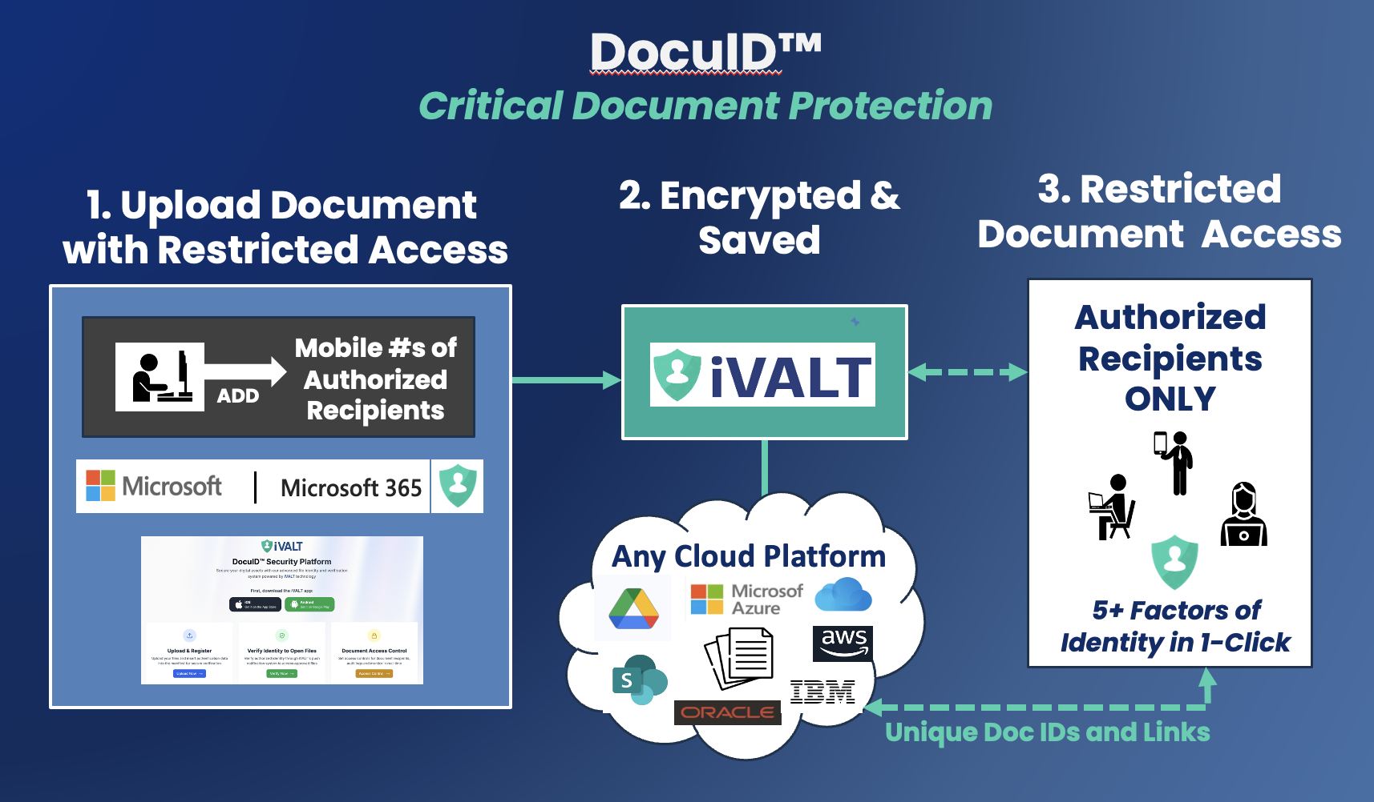
Protecting Critical Documents and Media

Slide 5
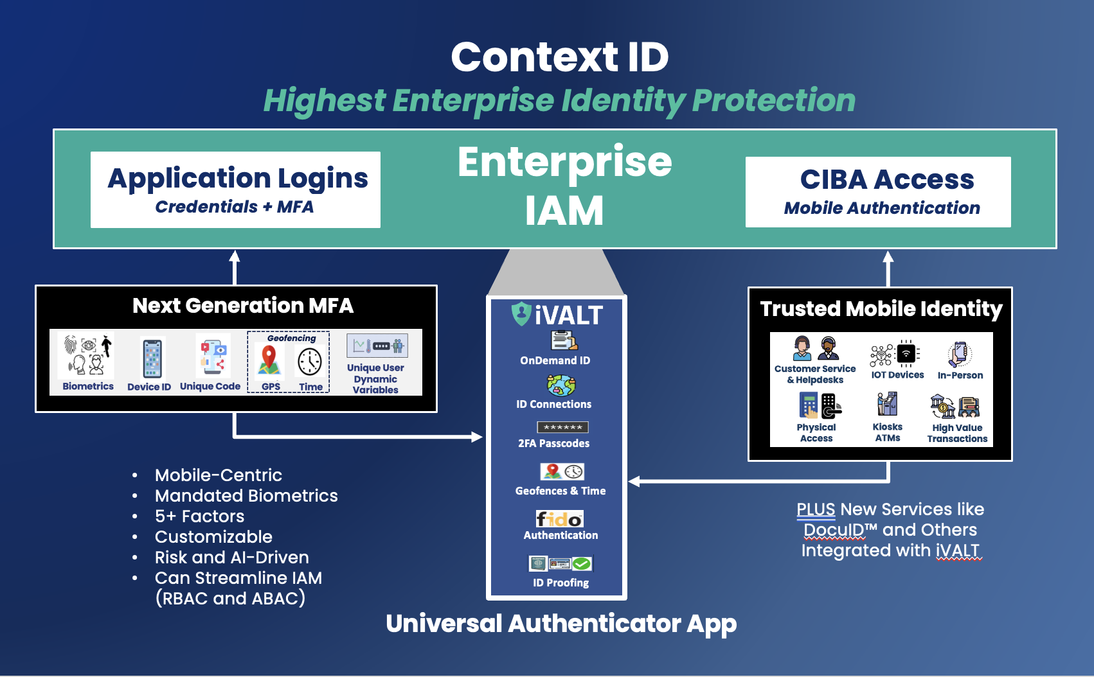
Emerging Enterprise Use Cases

Slide 6
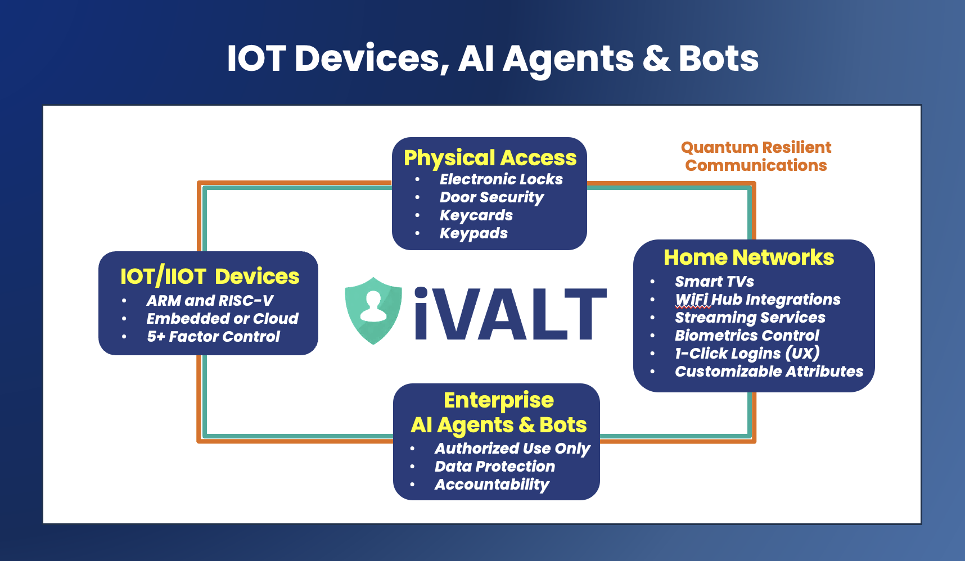
IOT and Quantum Resilience

Slide 7
